Slide 1
Dbatools for the Uninitiated
Notes:
How many use PowerShell?
Used sqlps, sqlserver or dbatools modules?
How many instances do you manage?
Any scripting?
Ever automated daily tasks?

Slide 2
Agenda
Advantages of Automation
History of Automation on Windows
PowerShell ❤ SQL Server
Demos
Notes:
Since 1999
Visit & thank sponsors & volunteers

Slide 3

Who am I?
Web Developer/Web Server Admin
Systems Integrator
Development DBA
Production DBA
dbatools Contributor
User Group Leader
SQL Saturday Organizer
Notes:
Since 1999
Visit & thank sponsors & volunteers

Slide 4
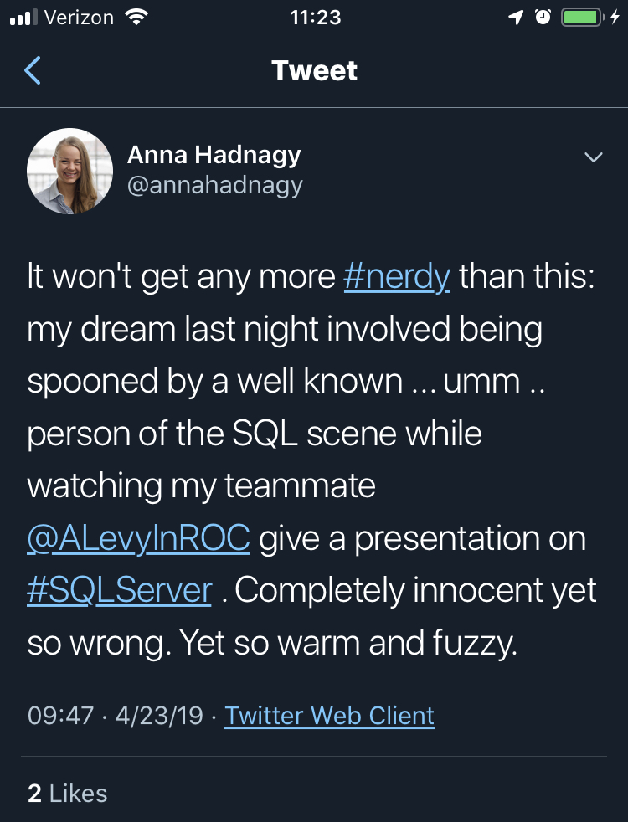
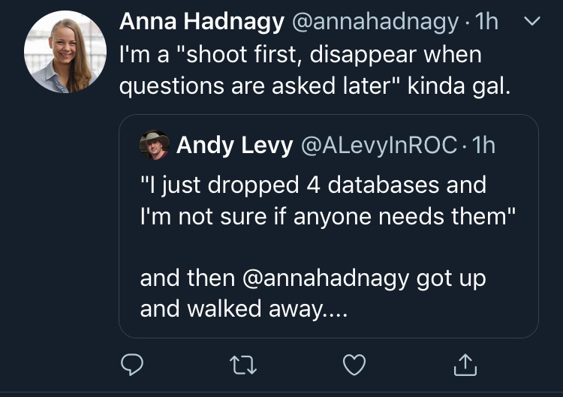
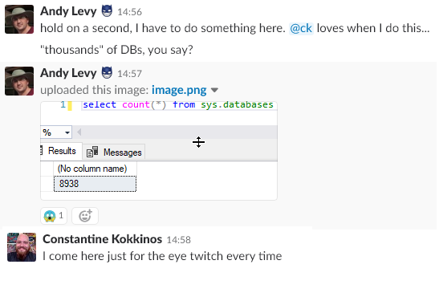
Who Am I?
Notes:
8K DBs - design problems get magnified at scale
She said I could!

Slide 5

NASA Goddard Space Flight Center from Greenbelt, MD, USA [Public domain]

Slide 6
Why Automate?
Documentation
Scripting is communication
Repeatable
Trackable
Scalable
Notes:
Documentation - better than Word
Trackable - “You can’t put clicks in source control”

Slide 7
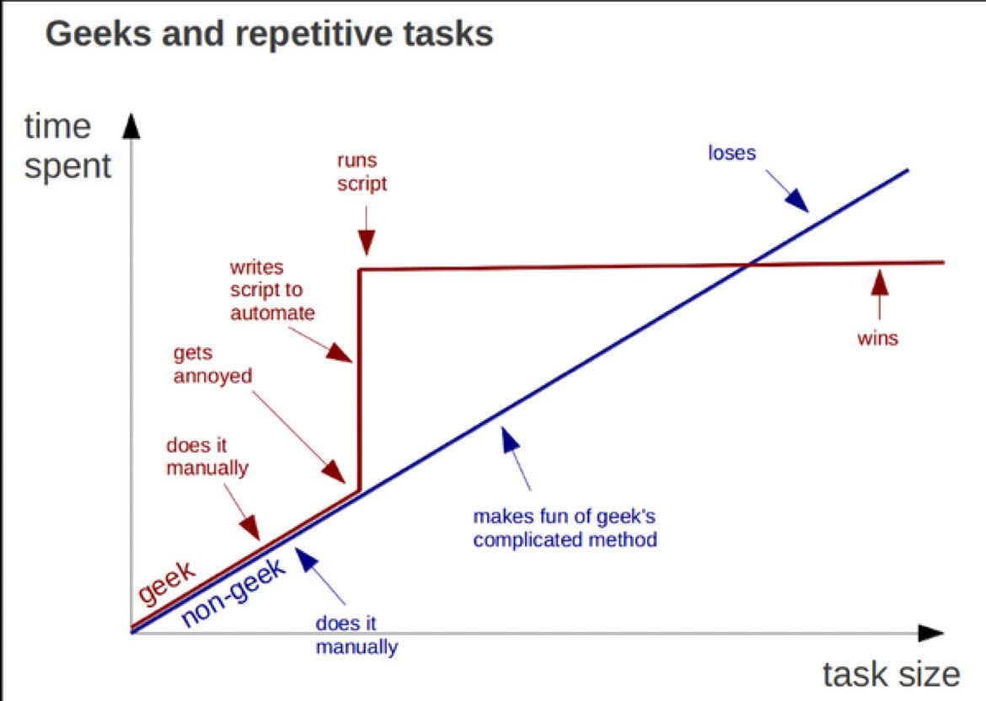
https://twitter.com/kirkdborne/status/804145411997007873

Slide 8
Microsoft & Automation
Ancient History - Batch/cmd files
The Middle Ages - Windows Scripting Host
The Renaissance (2006) - PowerShell 1.0
The Enlightenment (2016) - PowerShell Core
Notes:
Jeffrey Snover is now a Microsoft Technical Fellow

Slide 9
SQL Server & PowerShell
2008 - sqlps & PowerShell Agent Job Step
2016 - sqlserver
2017 - sqlserver in Powershell Gallery
Good starting point
Notes:
Module and cut-down version of PowerShell. Don’t use any of these
Released with SSMS 2016, then sat idle
Moved to gallery April 2017
See Drew’s session for more detail

Slide 10
Discovery
Get-Command/Find-DbaCommand
Get-Help
Get-Member
Notes:
TODO: Show Find-DbaCommand “Connect”

Slide 11
What is dbatools?
Open Source Powershell module for data professionals
BDFL Chrissy LeMaire
163 contributors
Started July 2014
1.0 on June 20, 2019
Notes:
Single purpose - now almost 550 functions

Slide 12


dbatools vs. sqlserver
Mega multitool vs. Swiss Army Knife
Breadth & depth
Release frequency
Community-driven
Notes:
Sqlserver: 107 functions
Dbatools: 558 functions

Slide 13
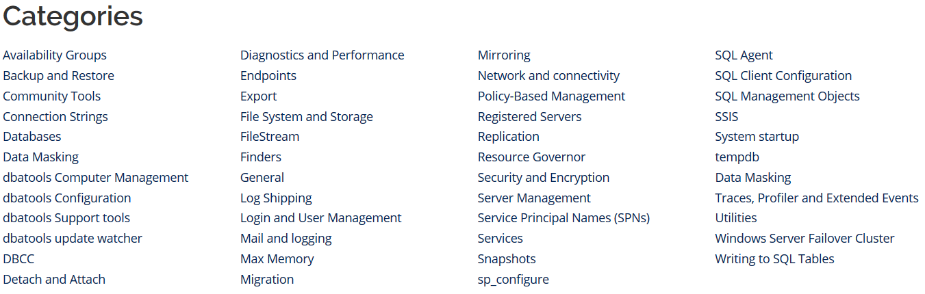
dbatools Function Categories
https://dbatools.io/commands/

Slide 14
SMO
Underpinning of Management Studio
Can be unwieldy

Slide 15
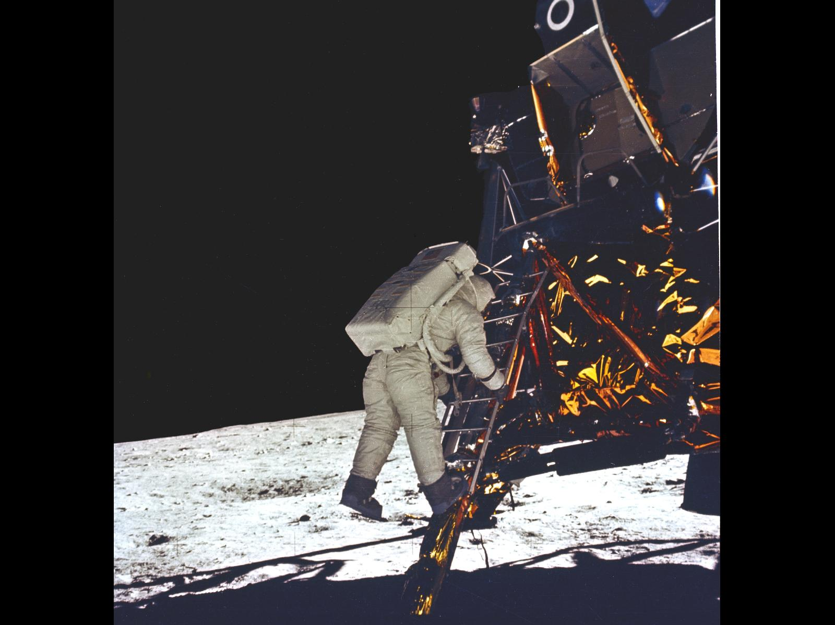

Slide 16


Slide 17
Contributing
Issues
Feature Requests
Documentation
Slack!
Code!

Slide 18
wrap-up
https://dbatools.io/
Check dbatools for a solution first
Safety first! Use –whatif and -verbose

Slide 19





Where to Find Me
https://flxsql.com/
andy@flxsql.com
@alevyinroc

Slide 20
Backup and Restore
Install Ola solution
Restore to point in time
Snapshots

Slide 21
Instance Migrations
Copy/update configuration
Copy security
Copy Agent jobs
Copy data

Slide 22
Monitoring
First responder kit
Whoisactive
Glenn berry queries
Watch-*

Slide 23
Maintenance
Ola hallengren
Compression

Slide 24
Validation
Test last backup

Slide 25
Automation
Migration
Copy databases
Configuration

